Slide 1
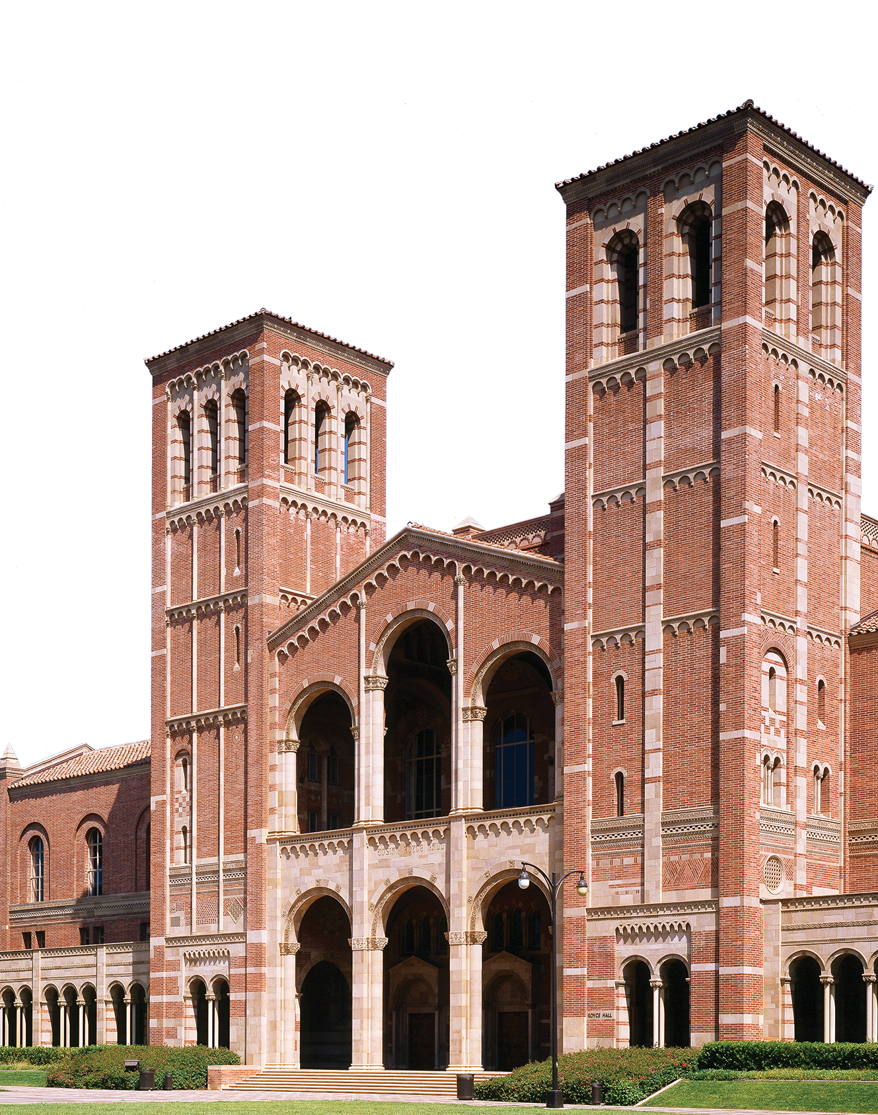


Howard Lee
Associate Director of External Relations and Recruitment

Slide 2








WE ARE UCLA
Notes:
We are VISIONARY-The people at UCLA are reshaping our world for the better: 14 Nobel Laureates, 11 National Medal of Science winners, 13 MacArthur Fellows, and 261 Olympic Medals.
We are OPEN: UCLA is community of ideas, respect, and optimism
We are DRIVEN: UCLA’s alumni are pioneers and innovators across every discipline, from Vinton Cerf, one of the founding fathers of the internet, to baseball legend Jackie Robinson.
We are GLOBAL: UCLA has long provided opportunities to students from around the globe. Students from over 100 countries make up our global student body.

Slide 3
About UCLA
One of the 10 University of California campuses
Founded in 1919
The second oldest UC campus
~48,000 students
The most applied to university in the USA. Receives over 160,000 applications annually
Approximately $10 Billion USD annual operating budget
summer.ucla.edu

Slide 4


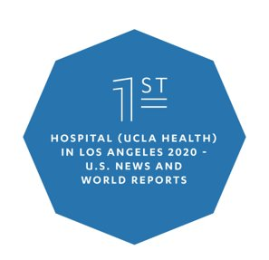
About UCLA
14 Nobel Laureates,
11 National Medal of Science Winners,
13 MacArthur Fellows,
3 Pulitzer Prize Winners,
A Fields Medal and an A.M. Turing Award,
261 Olympic Medals,
More than 140 Companies Created Based on Technology Developed at UCLA
Students from Over 100 Countries and All 50 States
summer.ucla.edu

Slide 5
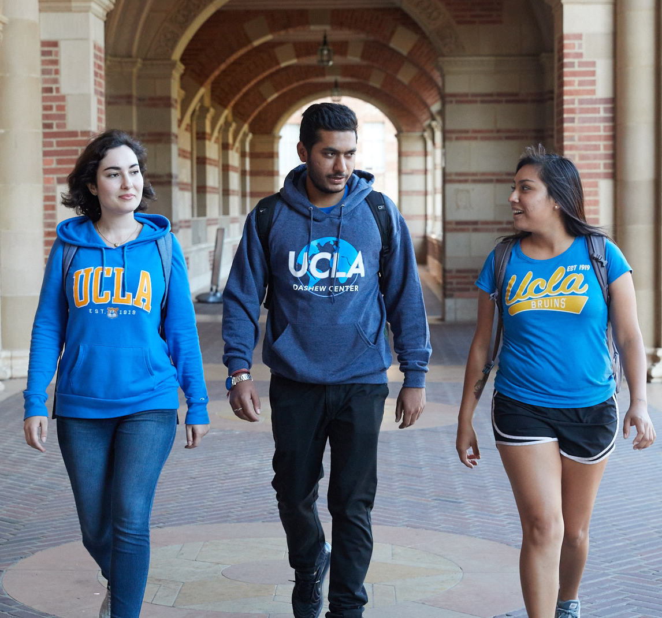
UCLA Summer Sessions Student Population
Source: UCLA Summer Sessions as of August 30, 2019

Slide 6
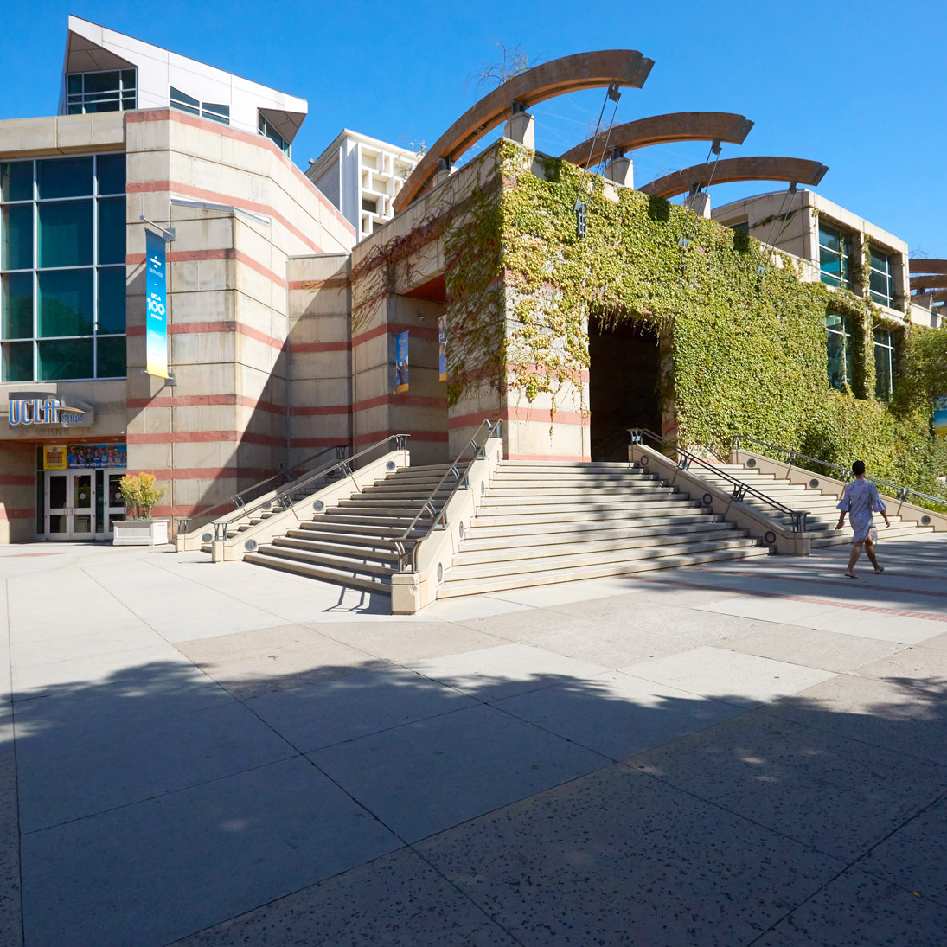
Benefits of UCLA Summer Sessions
Summer 2024:
June 24 – September 13, 2024
All courses and programs carry UCLA credit and are recorded on an official UCLA transcript.
80% of UCLA students participate in Summer Sessions before they graduate.
100+ subjects and 700+ courses offered.
Visiting students receive an official student ID and have access to all campus organizations and facilities.
Notes:
UCLA Summer Sessions offers a wide range of academic courses and summer institutes for visiting students. With over 100+ years of history serving both UCLA and visiting students, UCLA Summer Sessions upholds the high standards of education that defines UCLA. For Summer 2022, UCLA Summer Sessions will run programs from June 20 – September 9. There are a wide variety of reasons that make UCLA Summer Sessions particularly appealing to high school students, but in this slide I want to focus on three key things:
We are the only way for non-matriculated students to attend UCLA credit bearing courses and programs and to receive an official UCLA transcript. This is an incredible opportunity for high school students to earn college credit before stepping foot on a college campus as a university student. UCLA credit is transferable to UCLA, any UC campus, and most 4-year U.S. universities.
Study alongside the over 11,000 UCLA students that study with UCLA Summer Sessions each summer. The unique opportunity to take courses and learn alongside UCLA students allows high school students to learn more about life at UCLA and network.
We offer 100+ subjects amongst our courses and programs in time frames that span from 1 to 10 weeks long. This means that regardless of your academic interests and time commitments over the summer, you will be able to study with us at UCLA this summer!

Slide 7
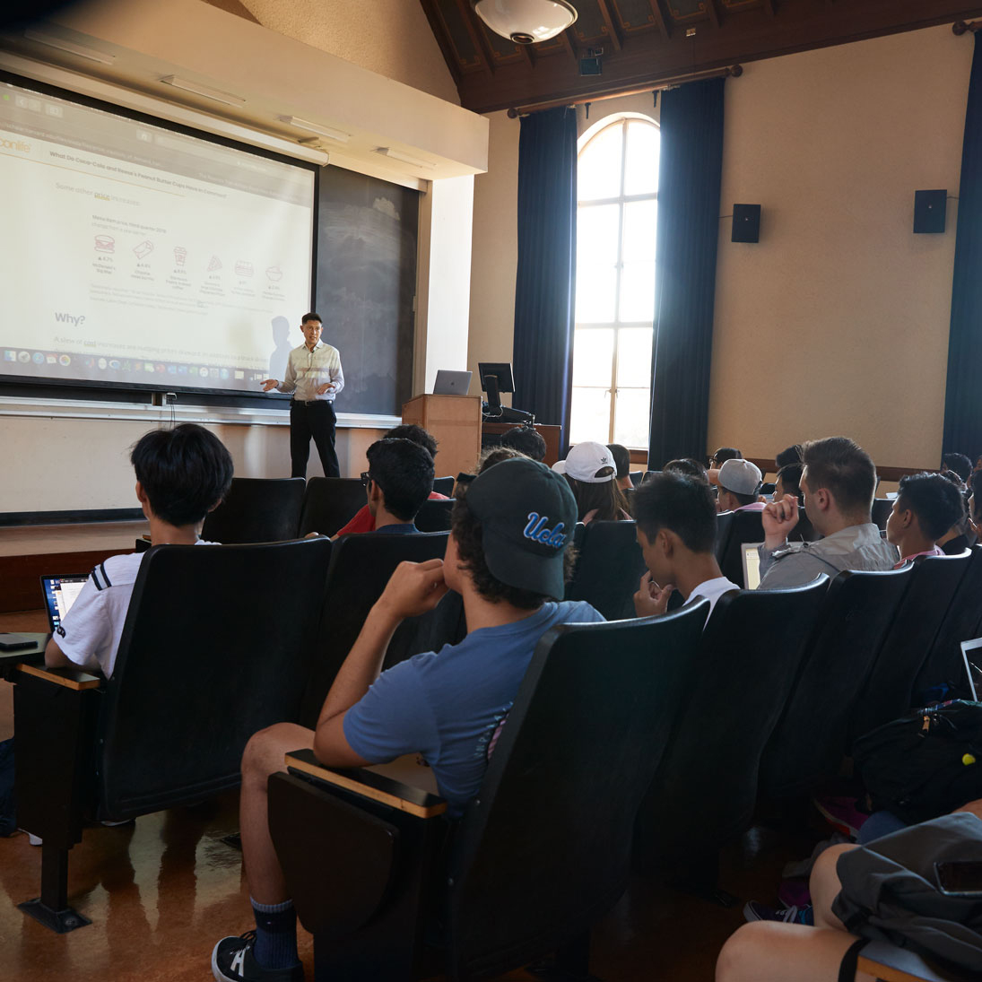

Summer Courses
6–10-week Signature UCLA Experience ​
  Session A6: Jun 24 – Aug 2
  Session C6: Aug 5 – Sep 13
  Schedule of Classes: sa.ucla.edu/ro/public/soc
Notes:
Other popular subject areas include Chemistry, Biology, Statistics, Psychology, and Political Science.
Preapproved HS List PDF: https://summer.ucla.edu/app/uploads/2022/01/CoursesForHighSchoolStudents_2022.pdf

Slide 8
English Proficiency
TOEFL: 80 (iBT)
IELTS: 6.5
CAE: B (CEFR C1)
CPE: C (CEFR C2)
TOEIC: 685
Duolingo DET: 105
If enrolling in ESL courses only, proof of English proficiency is not required.

Slide 9
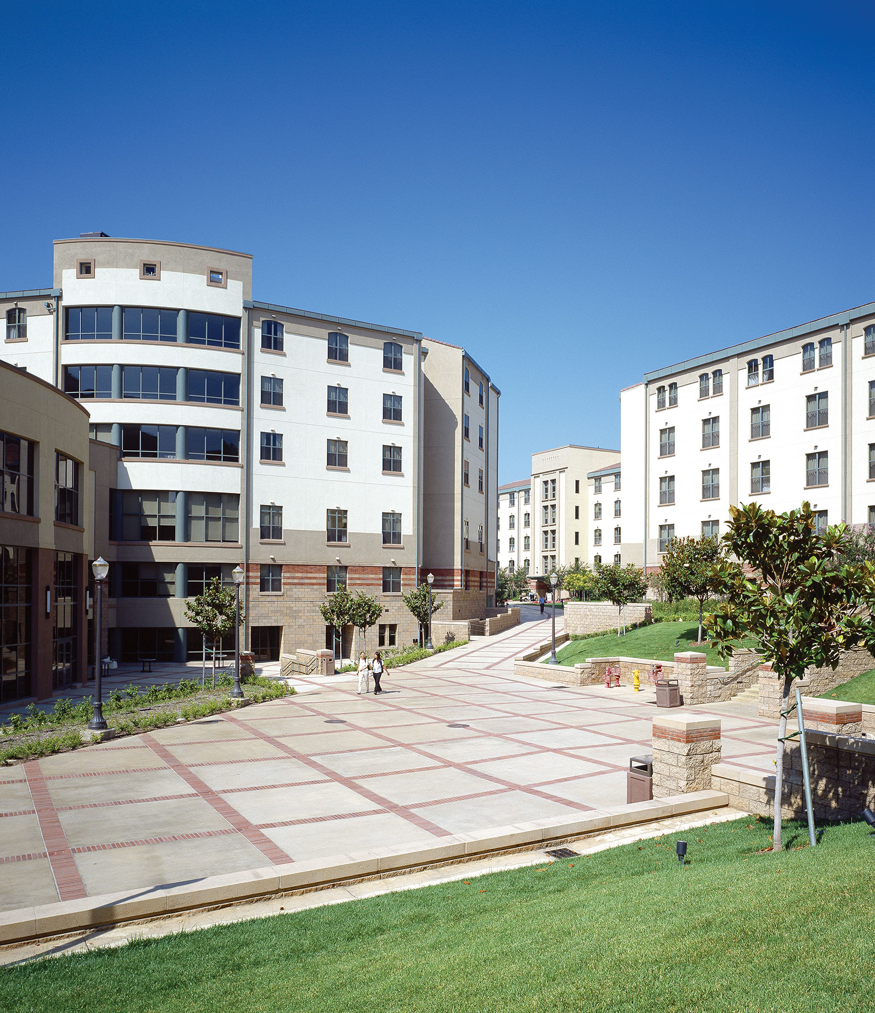
Live The UCLA Student Life On Campus
On-campus housing
Award-winning dining
UCLA’s on-campus housing is situated in the heart of university life and is just a short walk away from classrooms, laboratories, libraries, and sports facilities. Living in the UCLA residential community, you will have a home away from home at UCLA with access to additional resources and support right where you live.
UCLA Dining Services is an award-winning program that is nationally recognized for its high quality cuisine, state-of-the-art facilities, and innovative services. Offerings include pan-Asian fare, wood-fired pizza ovens, and late-night burgers.

Slide 10
Examples of Summer Housing

Slide 11
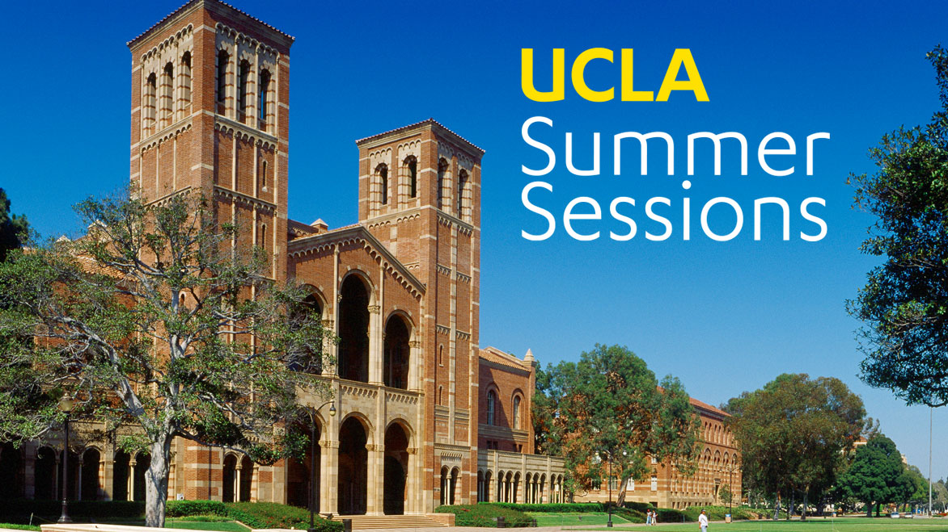
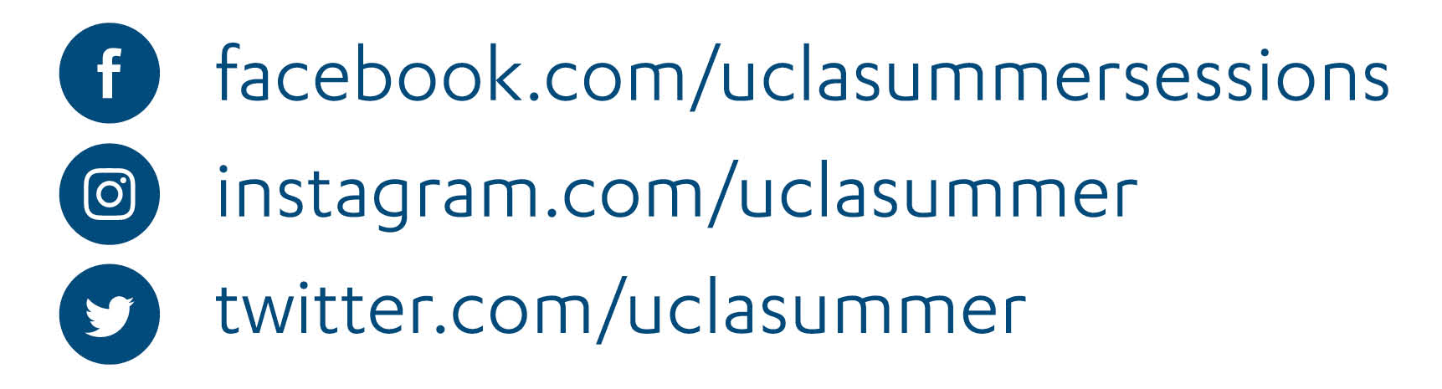
Connect with us!
QUESTIONS?
Notes:
Email Sign Up List: http://eepurl.com/hO_5jf

